Slide 1
How to Run MacBenesh Under Mac OS X
Arthur Ryman, Dancewrite
International BenMove Congress, Paris, 2017-07-06

Slide 2
About Me
Arthur Ryman is an independent software consultant currently developing a cloud-based web application for a major US water management company
His involvement with Benesh Movement Notation began around 1984 when he collaborated with his sister Rhonda Ryman Kane and his future wife Robyn Hughes Ryman on the development of the MacBenesh editor
He previously worked at the IBM Canada Laboratory from 1982 until his retirement from IBM in 2015
He obtained a Ph. D. in Mathematics from Oxford University in 1975

Slide 3
Agenda
Introduction
SheepShaver
MacBenesh
Moving files between OS X and OS 9
Printing to PostScript files
MS Word 6
FileType
Copying files from floppy disks

Slide 4
Introduction
MacBenesh let’s you create, edit, and print high-quality Benesh Movement Notation (BMN) scores on Mac OS 9
OS X Tiger and earlier could run OS 9 applications in Classic mode
OS X Leopard (2007) and later could NOT run OS 9 applications
Some MacBenesh users kept their old hardware running so they could keep using the application
Fortunately SheepShaver lets you run MacBenesh, and other OS 9 applications, on modern OS X hardware
We are grateful Sergei Konaev, the archivist at the Bolshoi Ballet, who brought this to our attention on 2015-02-07!

Slide 5
Workshop Resource Page
The best way to benefit from this session is to download the MacBenesh virtual machine onto your own MacBook and follow along during the workshop
We can also resolve any problems you hit
This presentation and all related files are available from:
http://dancewrite.com/SheepShaver/

Slide 7
The MacBenesh Virtual Machine Package
I have previously created a fully configured SheepShaver virtual machine package for MacBenesh
It contains SheepShaver, Mac OS 9, MacBenesh, MS Word, and other goodies
Download (or copy from a USB flash drive)
macbenesh-machine.sheepvm.zip
Unzip it onto your desktop and double-click the SheepShaver icon
SheepShaver will launch and you’ll see an OS 9 desktop in a new window
The only additional thing you need to do is configure the Shared folder
We’ll do that later
You can ignore the other installation and configuration instructions

Slide 8
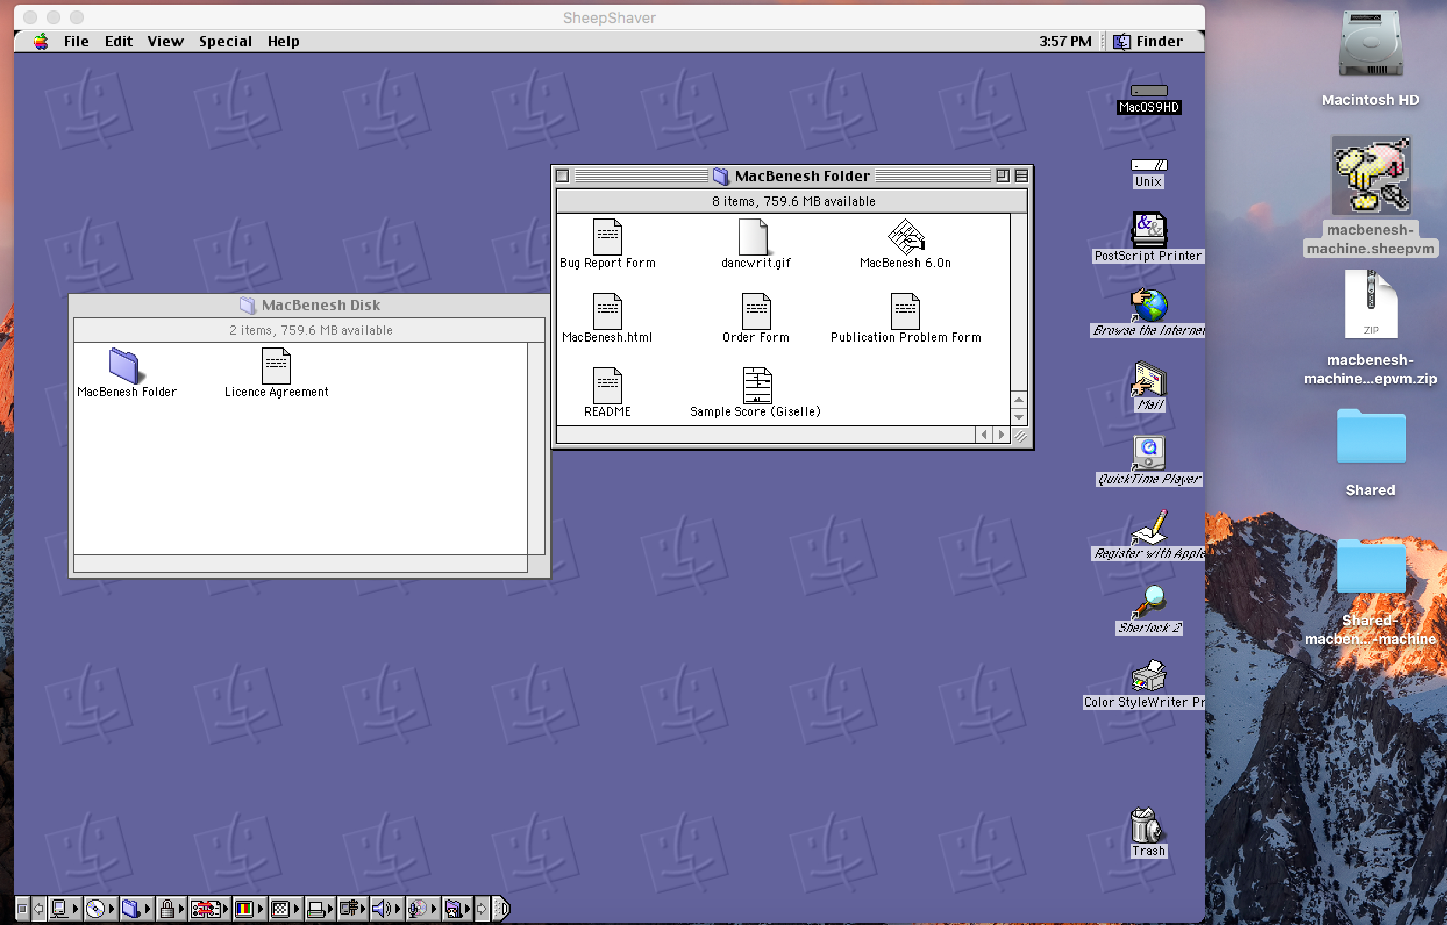

Slide 9
How the Virtual Machine Package was Created
Install SheepShaver in OS X
Install Mac OS 9 under SheepShaver
Create Shared folder to move files between OS X and OS 9
Install MacBenesh under OS 9
Create virtual PostScript Desktop Printer
Install MS Word 6 under OS 9
Install FileType under OS 9

Slide 10
If After the Workshop You Want to Create the Virtual Machine Package Yourself…
For your convenience, all of the files that you need to create the virtual machine package have been assembled into a single zip file:
macbenesh-osx-files.zip
Unzip macbenesh-osx-files.zip to your OS X machine
The folder named macbenesh-osx-file will be created
See the end of this presentation for links to where the components of macbenesh-osx-files.zip were obtained
You can download the components yourself from the original sources

Slide 11
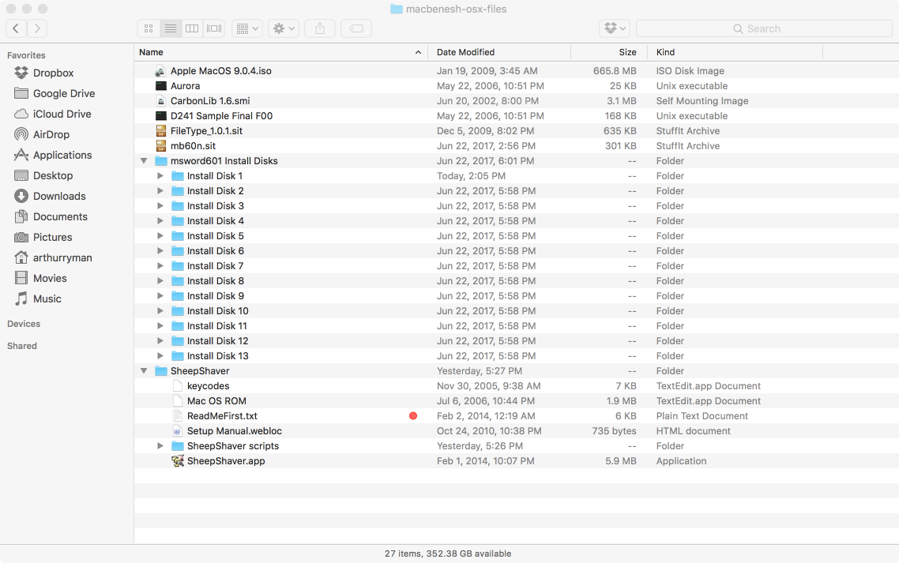

Slide 12
1. SheepShaver

Slide 13
Install SheepShaver
SheepShaver is an OS X application that emulates a PowerPC so you can run OS 9 applications again
Copy the SheepShaver folder from macbenesh-osx-files into your Applications folder

Slide 14
Note About the Mac OS ROM File
The SheepShaver application will quit immediately unless it finds a ROM file
Apple regarded their ROM file as proprietary and asked the developer of SheepShaver to not distribute it
I have already obtained and copied the Mac OS ROM file into the SheepShaver folder to simplify the installation process

Slide 15
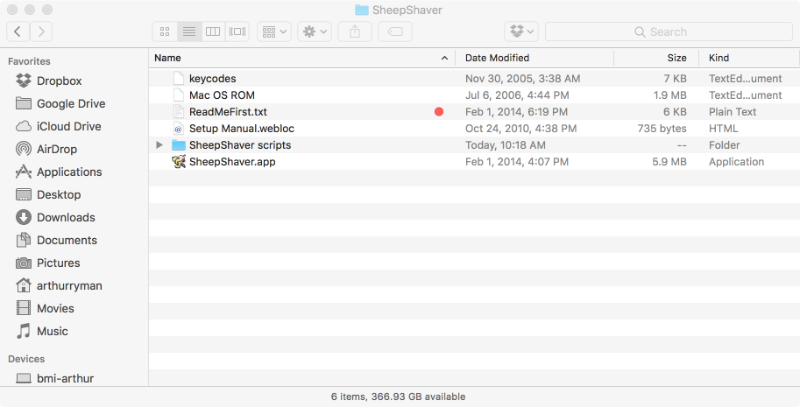

Slide 16
Launching SheepShaver
You can now launch SheepShaver but you’ll just see the diskette icon with a flashing question mark prompting you to install OS 9
At this stage the only way to quit SheepShaver is by pressing Control-Escape
Note that you may have to modify the Security Preferences for the application to allow SheepShaver to run

Slide 17
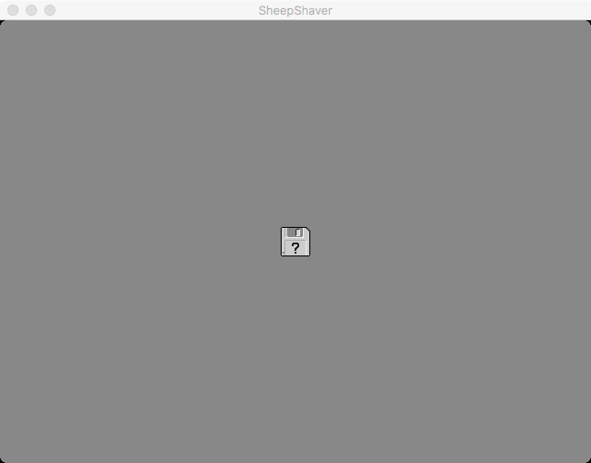

Slide 18
2. Mac OS 9.0.4

Slide 19
Locking the Mac OS 9.0.4 CD image file
Apple MacOS 9.0.4.iso is a CD image file that contains the Mac OS 9.0.4 installer
Copy MacOS 9.0.4.iso from macbenesh-osx-files to the Desktop
DO NOT double-click it since that will mount the CD image in OS X!
The CD image file must be read-only since real CDs are read-only
Select Apple MacOS 9.0.4.iso in Finder
Open the Get Info dialog box.
Check the Locked checkbox.

Slide 20
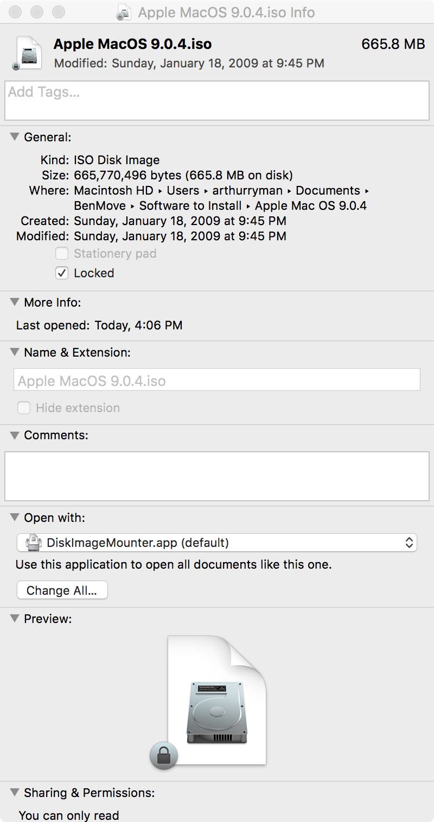

Slide 21
The Shared Folder
Create a folder named Shared on your OS X Desktop
This folder will appear as a folder named Unix in OS 9
Use this folder to move files between OS X and OS 9.
For example, when you print a MacBenesh score in OS 9, save the PostScript output file to the Unix folder, then go to OS X and drag it out of the Shared folder
Use this folder only as a temporary place for transferring files
DO NOT run OS 9 applications from the Unix folder

Slide 22
Configuring SheepShaver Virtual Machine Settings
Launch SheepShaver and select the Preferences menu item from the SheepShaver menu to open the Virtual Machine Settings dialog box
Configure the settings in each of the the three tabs as per the following slides:
Setup
Audio/Video
Miscellaneous

Slide 23
Virtual Machine Settings - Setup
Click the Create… button to create the disk image file for the virtual hard disk of the emulated Mac:
Save As: MacOS9 in the SheepShaver folder
Volume Size (MB): 1000
Click the Add… button and select the Apple MacOS 9.0.4.iso file you copied to the Desktop
ROM File: Click the Browse… button and select the Mac OS ROM file
Unix Root: Click the Browse… button and select the Shared folder
RAM Size (MB): 512

Slide 24
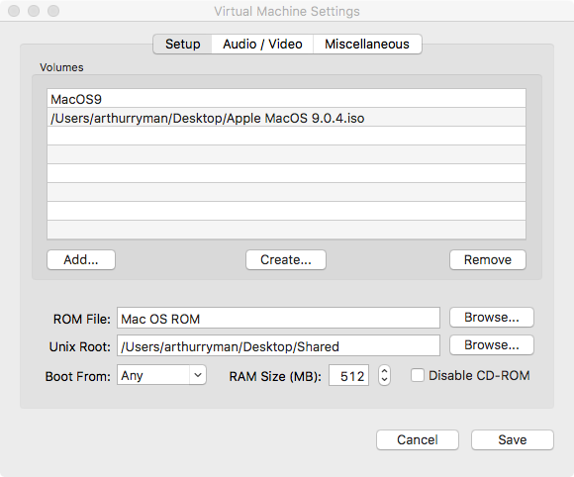
Select the Shared folder you created

Slide 25
Virtual Machine Settings – Audio/Video
Video Settings
Video Type: Window
Refresh Rate: Dynamic
Width: 1024
Height: 768
Enable QuickDraw Acceleration: checked
Audio Settings
Ignore these

Slide 26
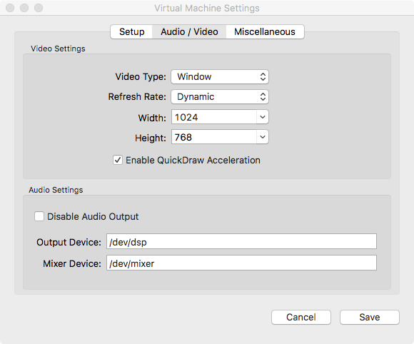

Slide 27
Virtual Machine Settings - Miscellaneous
CPU Options – check the following
Enable JIT Compiler
Allow Emulated CPU to Idle
Ignore Illegal Memory Access
Mouse/Keyboard - for non-US keyboards
Use Raw Keycodes: checked
Click the Browse… button and select the keycodes file in the SheepShaver folder
Serial/Network
Ethernet Interface: slirp

Slide 28
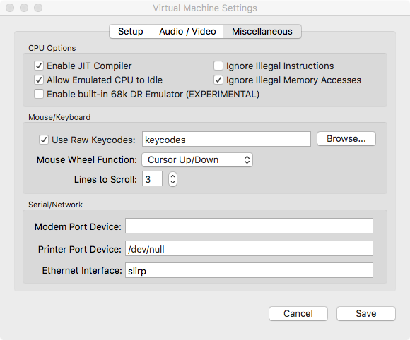

Slide 29
Booting SheepShaver from the CD image
Click the Save button to save the Virtual Machine Settings
Press Control-Escape to quit SheepShaver
Launch SheepShaver again
SheepShaver boots from the OS 9 CD image and detects an uninitialized hard disk
Name the virtual hard disk MacOS9HD
Select Mac OS Extended format
Click the Initialize button

Slide 30
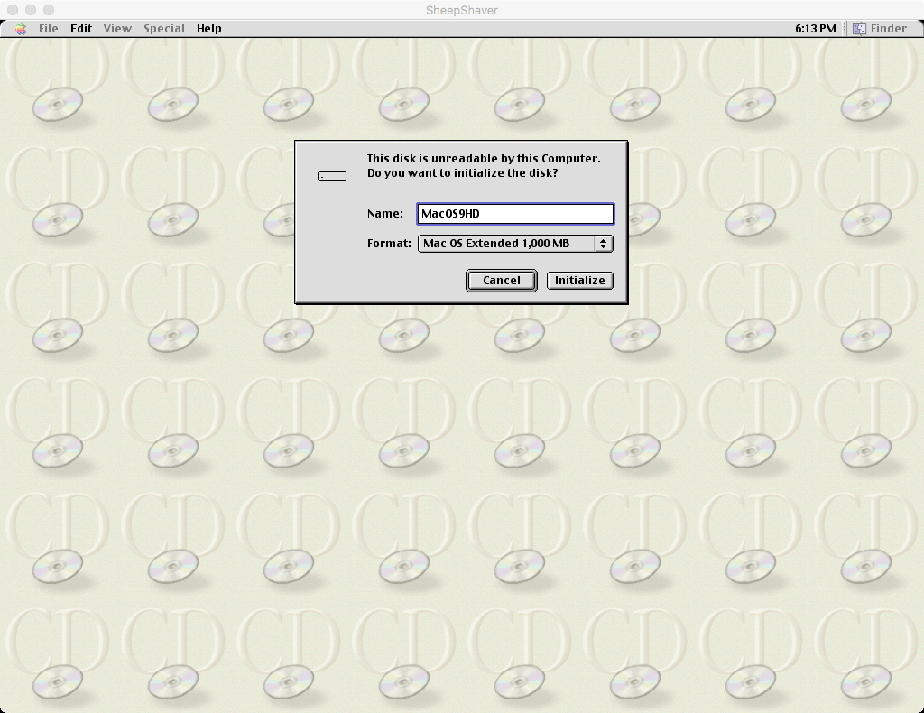

Slide 31
SheepShaver Booted from CD
After the virtual hard disk MacOS9HD is initialize the usual OS 9 Desktop is displayed
The CD is mounted as Mac OS 9
Double-click it to view its contents
The CD contains two installers which we need to run
Mac OS 9 Install – run this first
Mac OS 9.0.4 Update Install – run this next

Slide 32
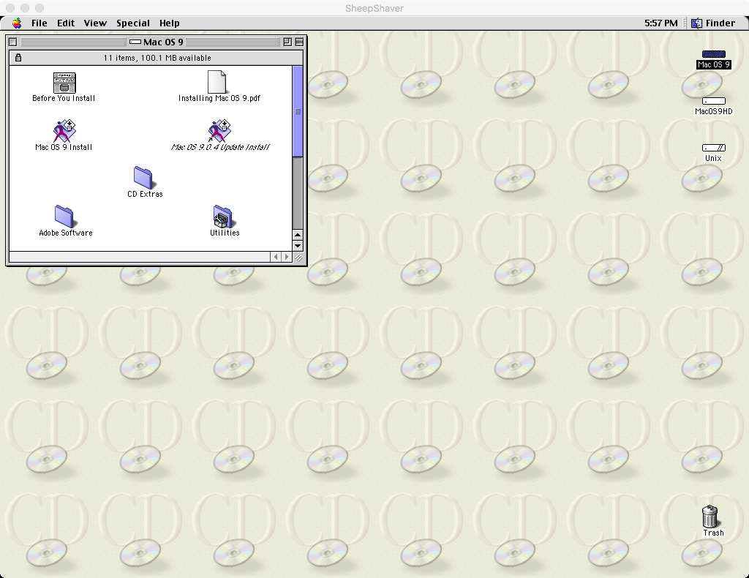

Slide 33
Installing Mac OS 9.0.4
Double-click the Mac OS 9 Install installer on the Mac OS 9 disk
Install Mac OS 9 as usual
The installation may appear not to make much progress initially, but be patient
Double-click the Mac OS 9.0.4 Update Install installer on the Mac OS 9 disk
Using SheepShaver Preferences, select the Apple MacOS 9.0.4.iso volume and click the Remove button
Removing the CD prevents SheepShaver from booting from it the next time you launch SheepShaver
You want SheepShaver to boot from the virtual hard disk MacOS9HD from now on
In OS 9, select the Special -> Shut Down menu item to cleanly shut down the virtual machine
SheepShaver quits

Slide 34
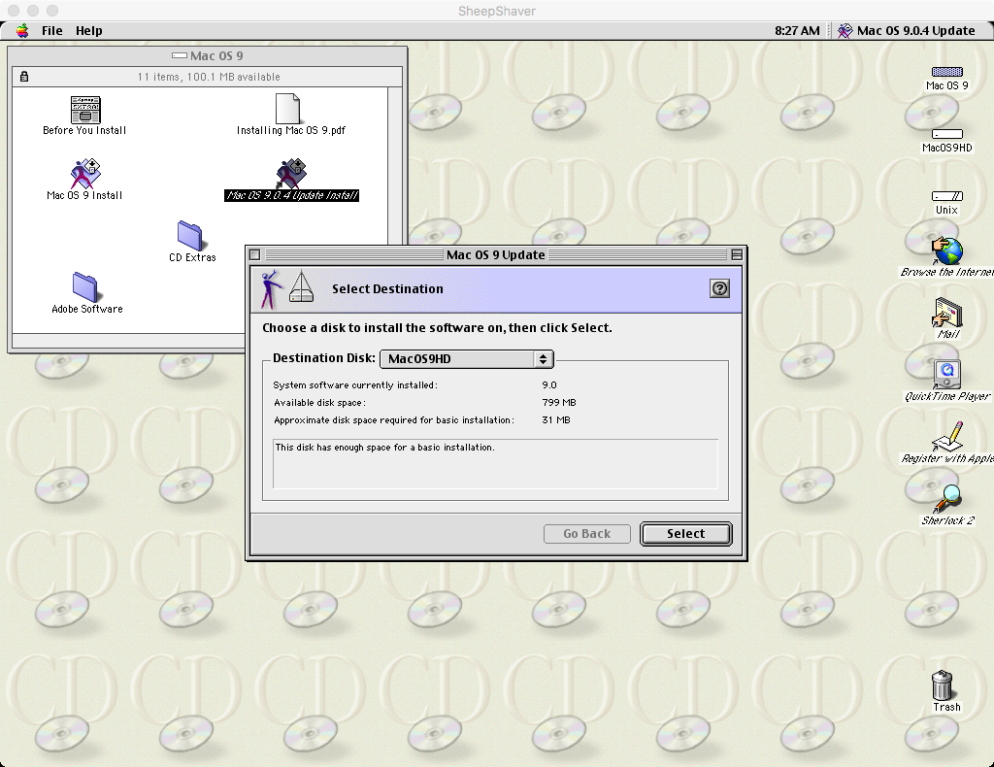

Slide 35
Running Mac OS 9 under SheepShaver
Launch SheepShaver
The virtual machine will now boot from the installed copy of Mac OS 9.0.4 on the virtual disk MacOS9HD
The Mac OS Setup Assistant runs the first time you boot from the newly installed Mac OS
This program will probably freeze!
To exit SheepShaver press Control-Escape, then launch SheepShaver again
You now have Mac OS 9.0.4 installed and running
You can configure network, sound, etc. but you won’t need these for using MacBenesh
You can toggle SheepShaver between window and full-screen display mode by pressing Control-Return

Slide 36
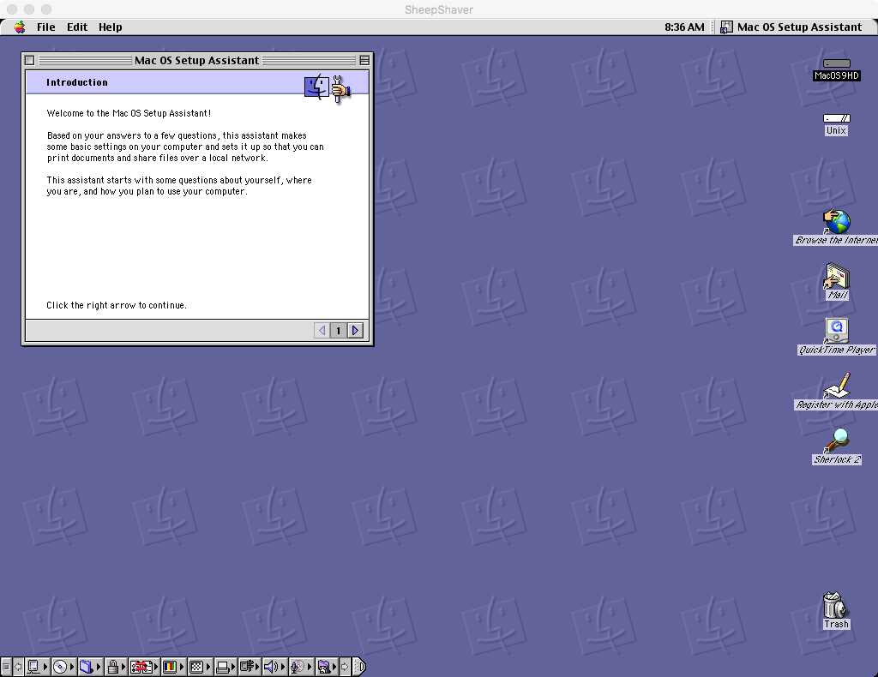

Slide 37
3. MacBenesh 6.0n

Slide 38
Install MacBenesh
The latest version is MacBenesh 6.0n
You should have a file named mb60n.sit which is a Stuff-It archive
In OS X copy mb60n.sit from macbenesh-osx-files into the OS X Shared folder then in SheepShaver drag mb60n.sit from the OS 9 Unix folder into the MacOS9HD virtual hard disk
In SheepShaver, double-click the mb60n.sit file to expand it
This creates the MacBenesh Disk folder which contains MacBenesh Folder
Open MacBenesh Folder
It contains the MacBenesh 6.0n application and Sample Score (Giselle)
MacBenesh is now installed

Slide 39
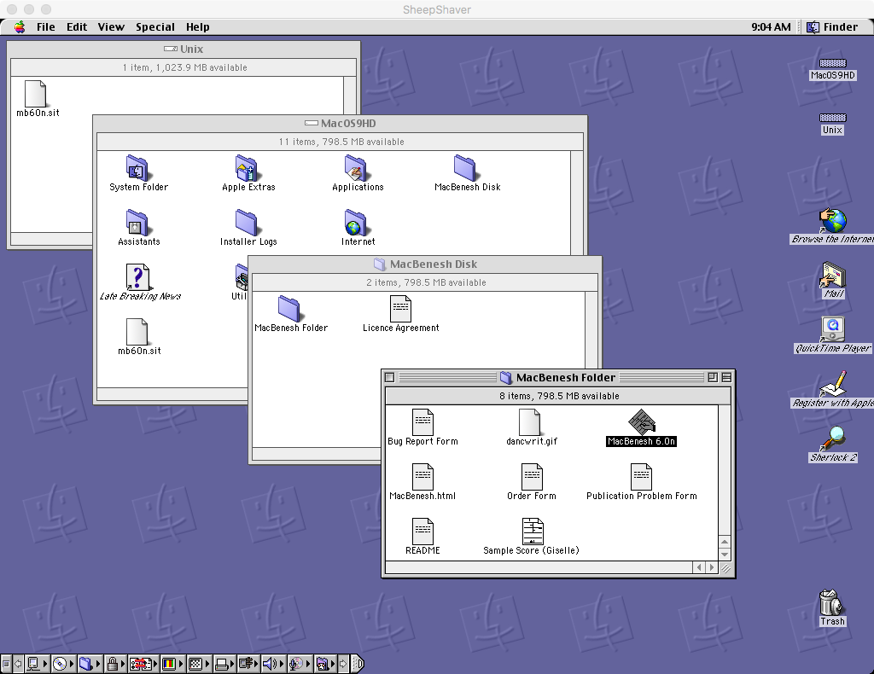

Slide 40
Increasing MacBenesh Memory
MacBenesh memory is set at 1024 KB which is too low for use with SheepShaver
You will probably see Low Memory warnings
Select the MacBenesh 6.0n application and open the Get Info dialog box
Show: Memory
Set Preferred Size: 4096 KB
Set Minimum Size: 4096 KB

Slide 41
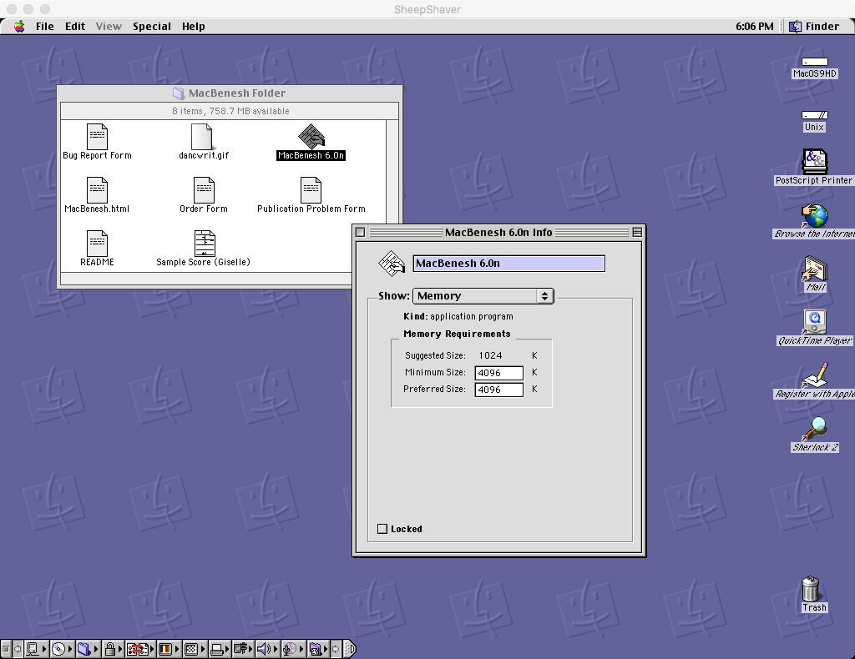

Slide 42
MacBenesh Licence Info
Launch MacBenesh 6.0n
A Licence Info window appears if you have not yet entered this information
MacBenesh 6.0n is free for use and has a special licence key
Enter your name
Enter the special licence key 6688167
Click the Save button
Quit MacBenesh and launch it again
The Licence Info window should NOT appear now

Slide 43
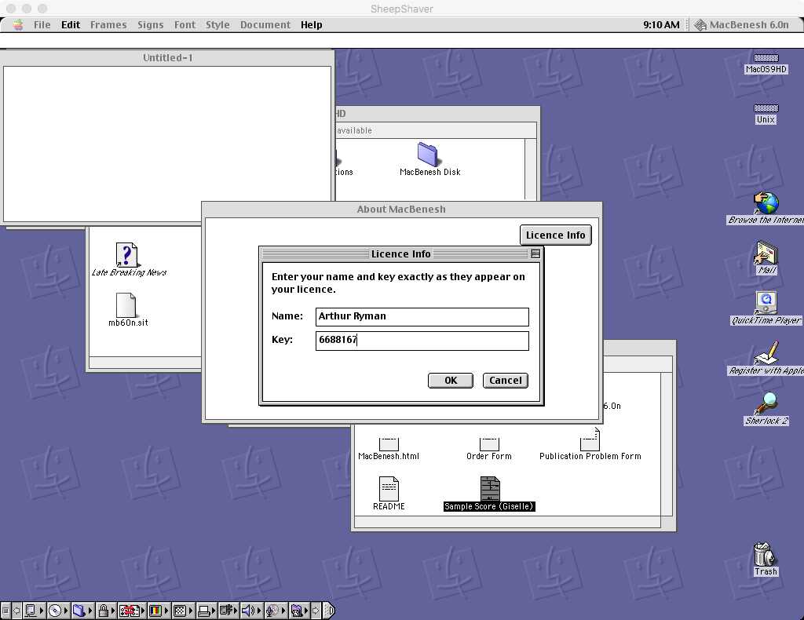

Slide 44
Open the Sample Score
You can launch MacBenesh by double-clicking the application or a score
Bug: Double-clicking a score launches MacBenesh but does not open the score
You need to open the score using the File -> Open menu item
Verify that MacBenesh is working correctly by opening Sample Score (Giselle) using the File -> Open menu item

Slide 45
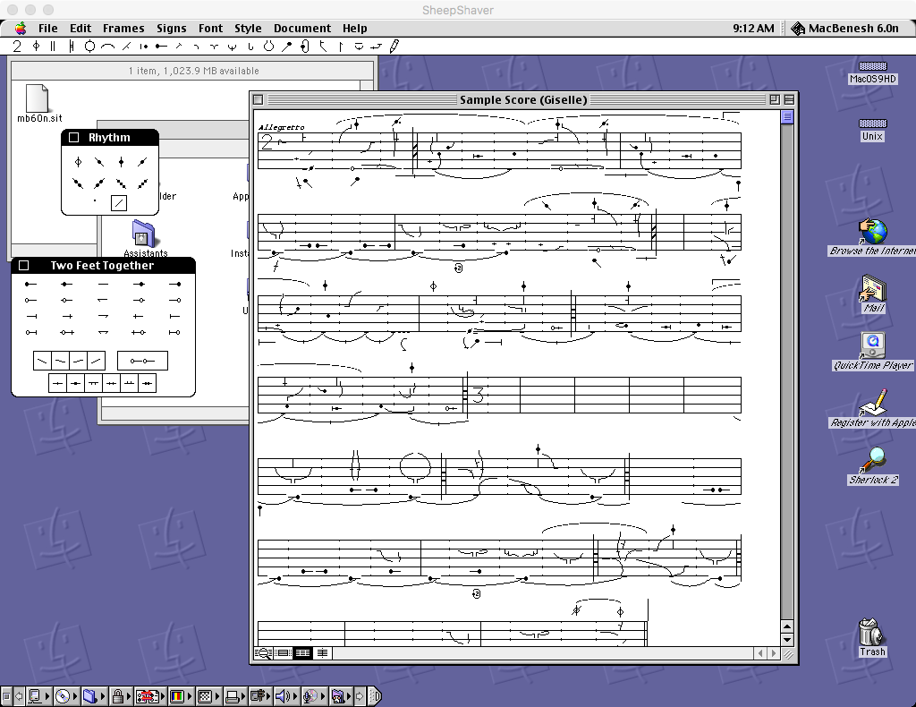

Slide 46
Printing Scores to PostScript
To use MacBenesh with other OS X applications, print the score to a PostScript file in OS 9 and then convert the PostScript file to PDF in OS X
View in Preview
Edit in Adobe Illustrator
To print the score to PostScript you must create a virtual PostScript printer in OS 9
In OS 9, launch the Desktop Printer Utility application
Located in the MacOS9HD -> Apple Extras -> Apple LaserWriter Software folder
Select
With: LaserWriter 8
Create Desktop…: Translator (PostScript)
Click the OK button

Slide 47
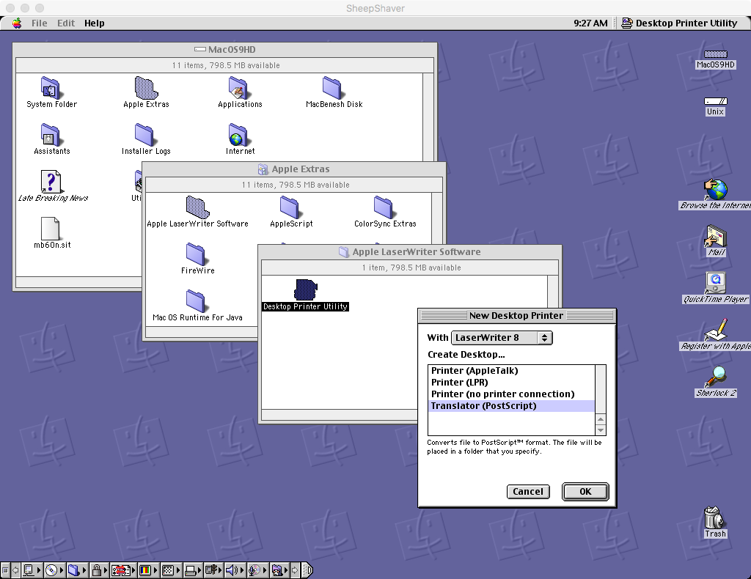

Slide 48
Creating a New Desktop Printer
Save the printer to the Desktop
Name the printer: PostScript Printer
Click the Save button
An icon named PostScript Printer appears on the Desktop

Slide 49
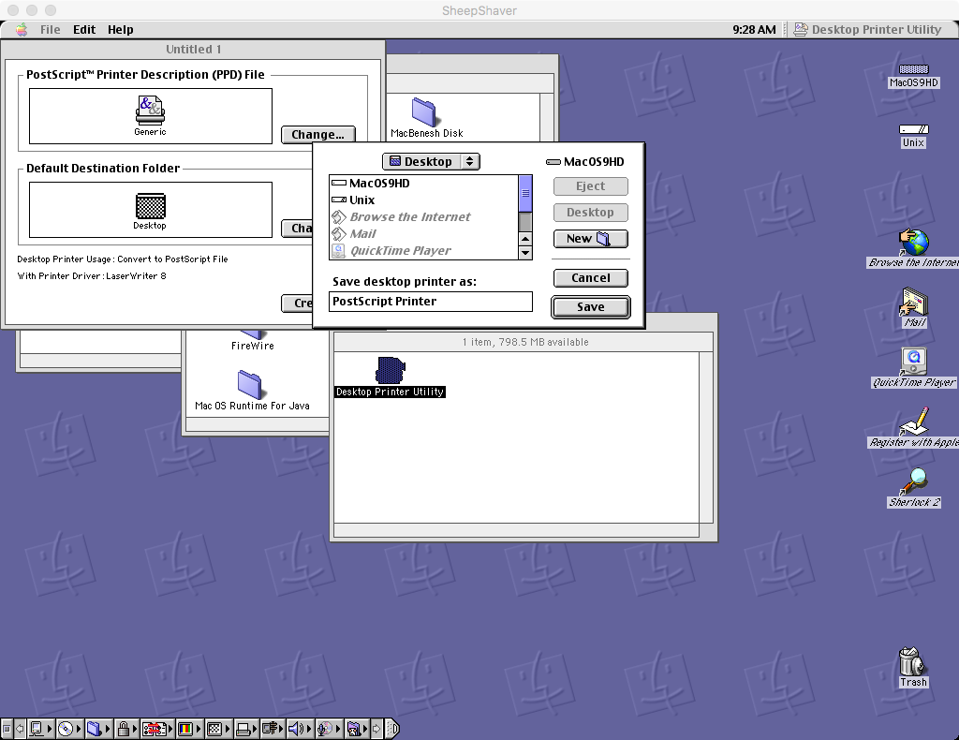

Slide 50
Selecting the PostScript Printer
Mac applications print to the printer selected by the Chooser
From the Apple menu, select the Chooser menu item
Select the LaserWriter 8 printer driver
Close Chooser

Slide 51
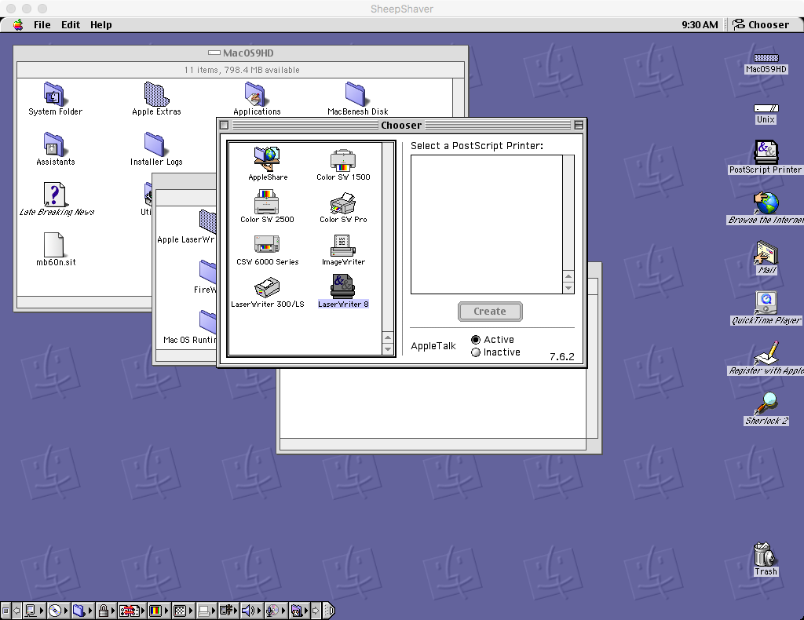

Slide 52
Printing the Sample Score
Launch MacBenesh and open the sample score
Select the File -> Print menu item
The Print dialog box should show the following settings
Printer: PostScript Printer
Destination: File
Click the Save button
Next you need to enter where the PostScript file should be saved

Slide 53
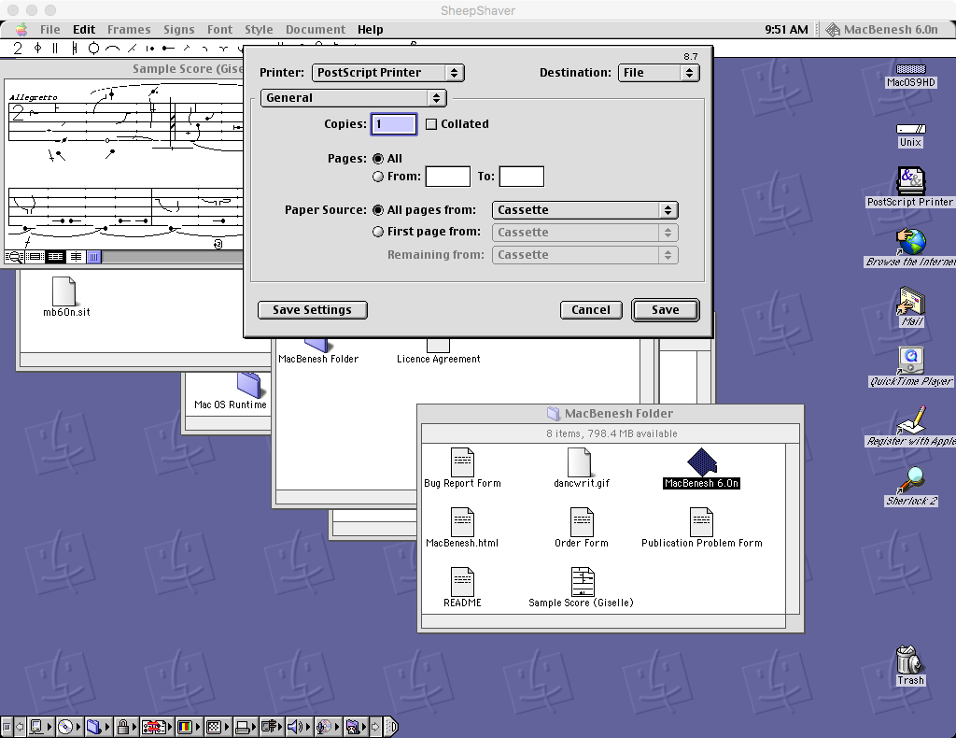

Slide 54
Saving PostScript Files to the Unix Folder
After you create the PostScript file you’ll need to move it to OS X in order to work with it further so create it in the Unix folder
Select the destination to be the OS 9 Unix folder
This corresponds to the OS X Shared folder
Click the Save button
MacBenesh will send the print output to the virtual PostScript printer
After a few seconds a PostScript file will appear in the Unix folder

Slide 55
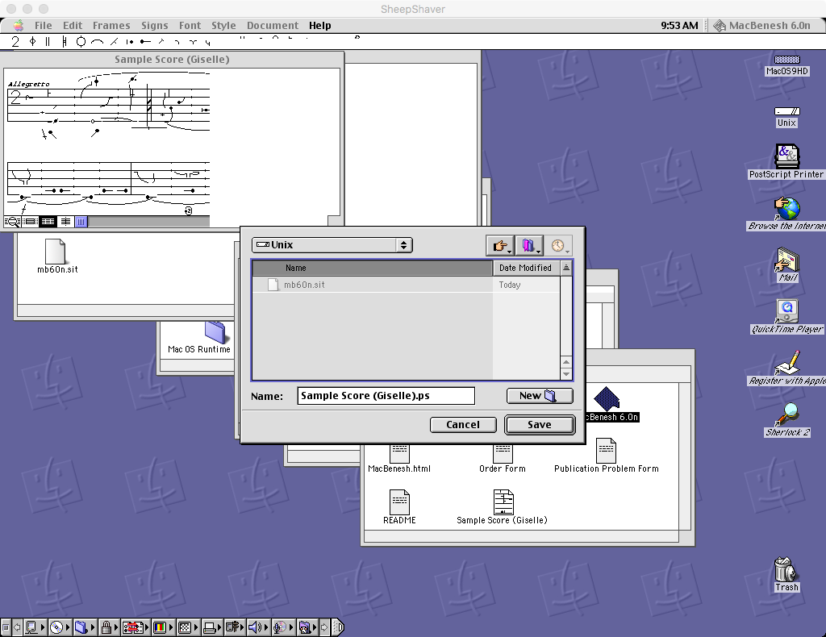

Slide 56
Converting PostScript to PDF
In OS X open the Shared folder and double-click the new PostScript file Sample Score (Giselle).ps
Preview launches and automatically converts the file to PDF
Save the PDF file in another OS X folder
Only use the Shared folder for temporary file transfers between OS 9 and OS X
Important files should be kept permanently in other OS X folders
You now can create and edit MacBenesh scores in OS 9 and convert them to PDF in OS X!

Slide 57
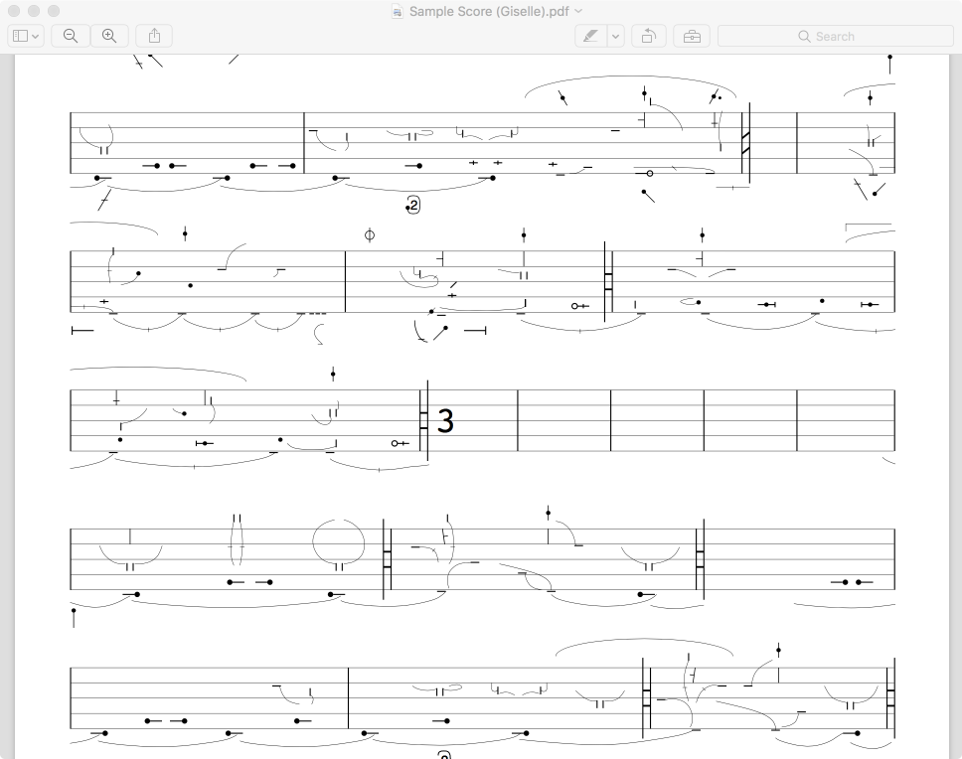

Slide 58
4. MS Word 6

Slide 59
Using MacBenesh with MS Word 6
You can copy and paste notation frames between MacBenesh and MS Word 6
Notation frames pasted into MS Word 6 print with high quality
MacBenesh used QuickDraw comments to preserve editable versions of the notation frames in clippings
Microsoft dropped support for QuickDraw comments in later versions of MS Word
Using SheepShaver you can install MS Word 6 and work with your old documents!

Slide 60
Installing MS Word 6.0.1
The msword601 Install Disks folder contains the setup program for MS Word 6.0.1
The installer came on 13 diskettes
In OS X copy the msword601 Install Disks folder from macbenesh-osx-files into the Shared folder then in OS 9 move it from the Unix folder onto the MacOS9HD virtual hard disk
In OS 9 open the MacOS9HD -> msword601 Install Disks -> Install Disk 1 folder
You should see the Microsoft Word Setup program

Slide 61
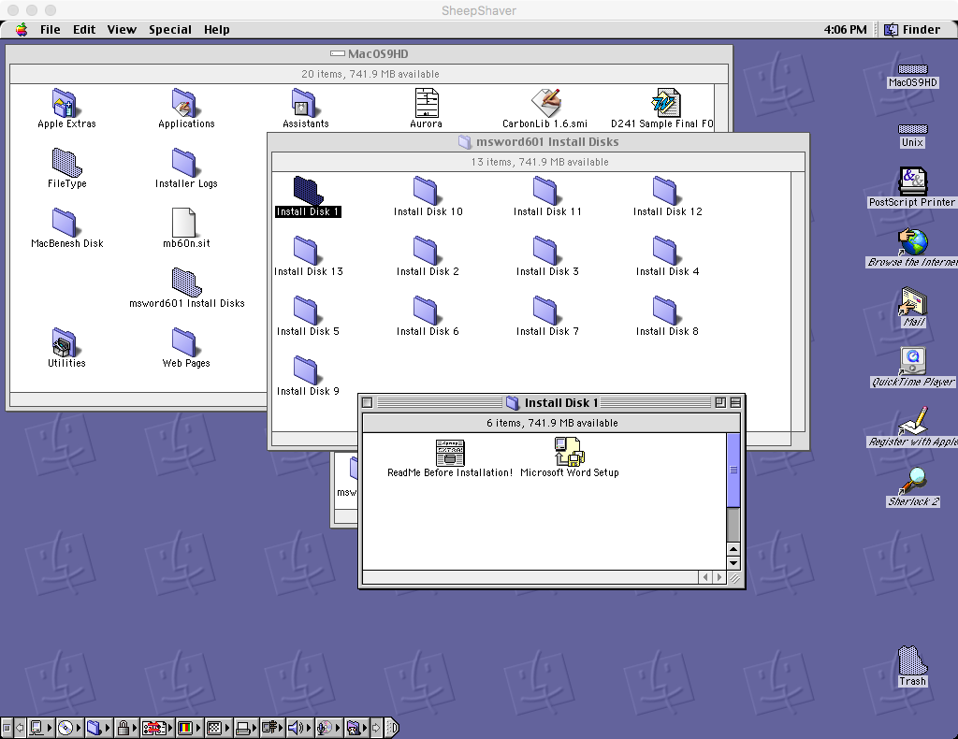

Slide 62
Run Microsoft Word Setup
Double-click the Microsoft Word Setup program
The installer starts
Follow the installation process as usual
MS Word 6.0.1 should now be installed

Slide 63
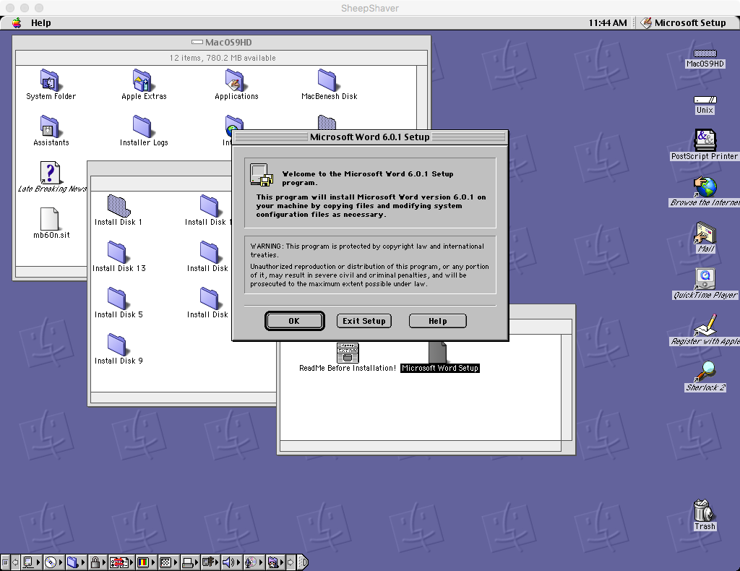

Slide 64
5. FileType

Slide 65
Accessing Your Old Documents
If you have floppy disks that contain old MacBenesh or MS Word documents you’ll need to plug in an external floppy disk drive and copy them to your OS X disk
Borrow my SmartDisk VST Floppy Drive during this workshop
You may also have old documents on CDs, DVDs, as email attachments, etc.
You may need to restore the OS 9 File Type and File Creator (File Info) on these files in order to open them in MacBenesh
The following screenshot shows two old documents that are missing their File Info:
Aurora (MacBenesh)
D241 Sample Final F00 (MS Word)

Slide 66
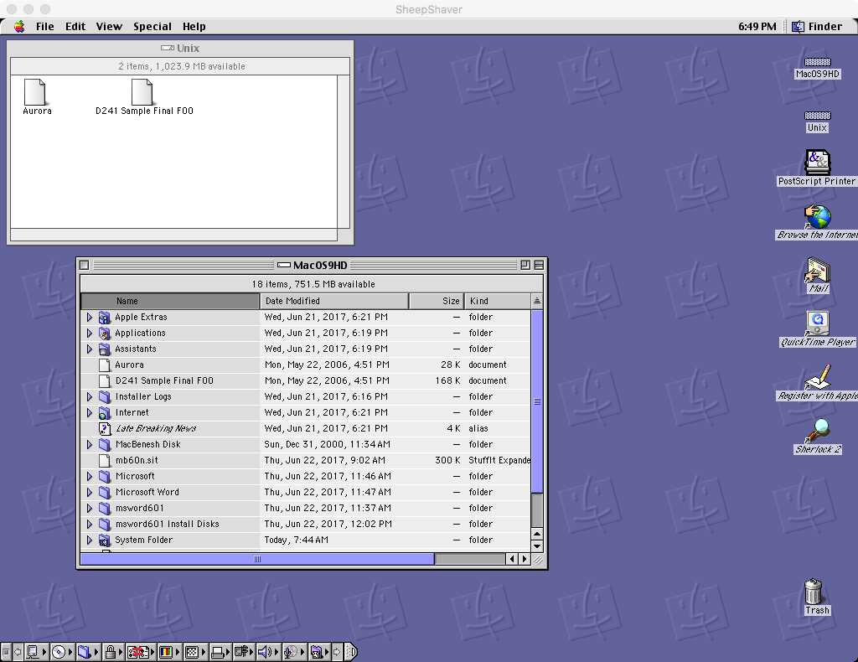

Slide 67
FileType and CarbonLib
FileType is a Mac application that lets you edit the File Type and Creator info on documents
FileType requires CarbonLib which is a runtime library provided by Apple
Copy the files CarbonLib 1.6.smi and FileType_1.0.1.sit from macbenesh-osx-files into the OS X Shared folder
You should also copy the sample files Aurora and D241 Sample Final F00 from macbenesh-osx-files to practice setting File Info
Open SheepShaver and copy the files out of the OS 9 Unix folder and into MacOS9HD

Slide 68
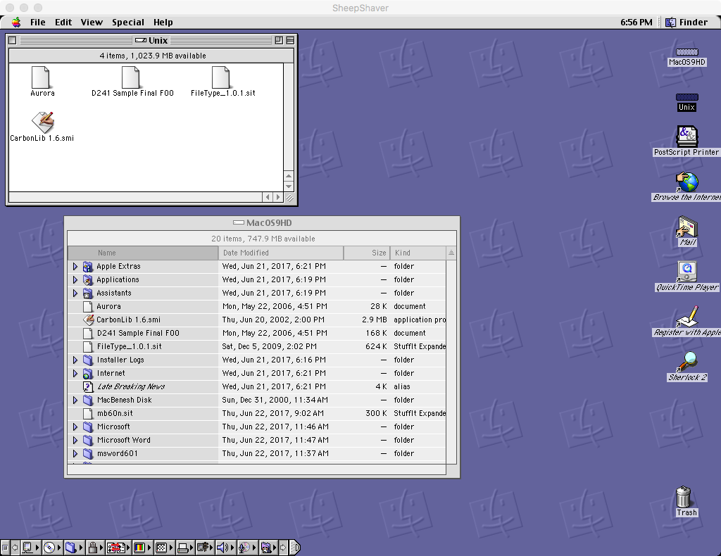

Slide 69
Installing CarbonLib 1.6
CarbonLib 1.6.smi is a self-mounting image of the installer for CarbonLib 1.6
Double-click CarbonLib 1.6.smi and run it
This mounts a virtual diskette named CarbonLib that contains the installer named Apple SW Install
Double-click Apple SW Install and run it
This installs CarbonLib 1.6 and restarts OS 9.

Slide 70
Installing and Running FileType 1.0.1
Double-click the StuffIt archive FileType_1.0.1.sit to unstuff it
This creates a folder named FileType which contains the FileType.app application
Launch MacBenesh select the File -> Open menu item and try to open Aurora
Note that Aurora is not listed in the Open dialog because it has lost its File Info in the process of being transferred from OS 9 to OS X
We’ll restore its File Info using the FileType application later
Cancel the Open dialog

Slide 71
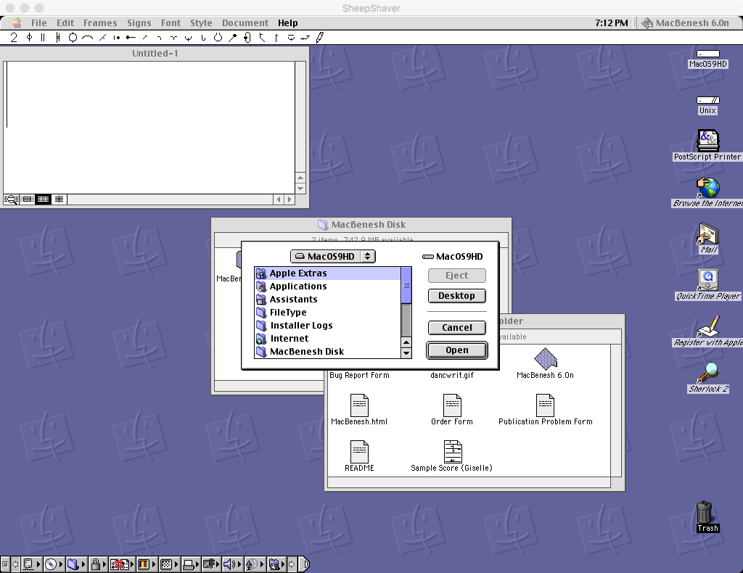

Slide 72
Setting File Info for MS Word Documents
Launch the FileType.app application
Click the Add File… button and add the file D241 Sample File F00
In the Change file type to: list select Microsoft Word Document
Click the Change button
This sets the File Info to MS Word
Now you can open D241 Sample File F00 by double-clicking it in Finder

Slide 73
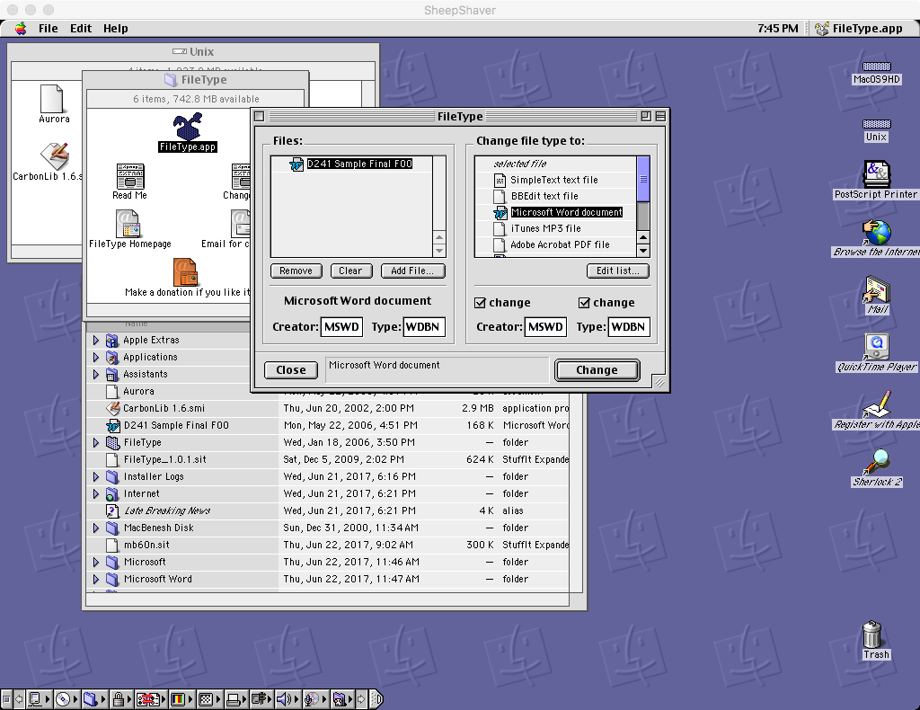

Slide 74
Setting File Info for MacBenesh Documents
Click the Clear button to clear the Files: list
Click the Add File… button and add Aurora
Select Aurora and enter the values:
Creator: BNSH
Type: BSCR
Click the Change button
This sets the File Info for Aurora to the values used for MacBenesh documents
Now Aurora will appear in the MacBenesh Open dialog

Slide 75
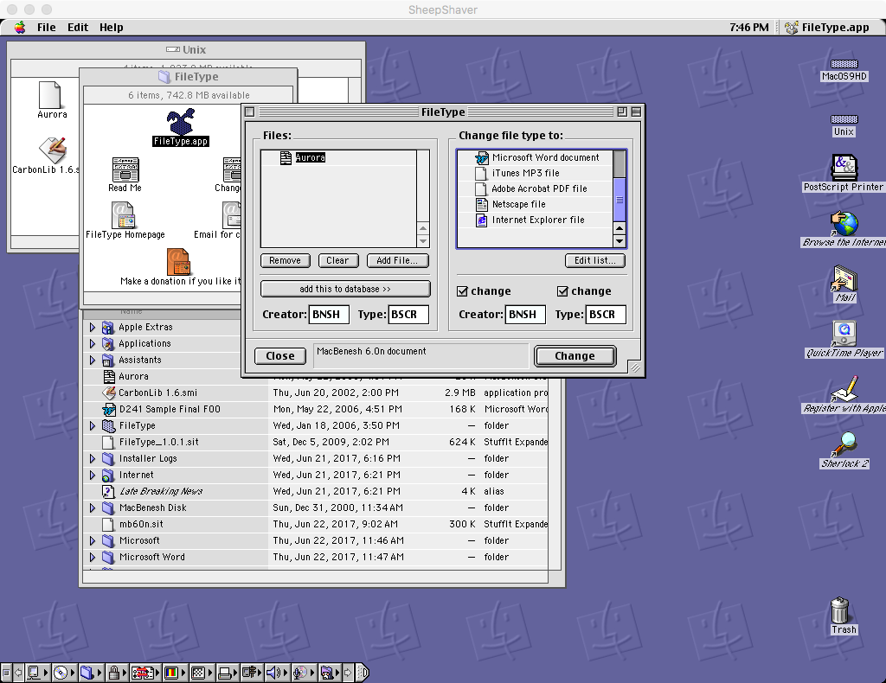

Slide 76
Adding MacBenesh to the FileType Database
You can save the File Info values used for MacBenesh documents in the FileType application by adding it to the FileType database
With Aurora selected, click the add this to database >> button
Name the entry: MacBenesh Score
You can now use this database entry to easily set the File Info for other MacBenesh scores just like you did for MS Word documents

Slide 77
Conclusion

Slide 78
Summary
SheepShaver lets you run Mac OS 9 applications such as MacBenesh and MS Word 6 on modern Mac hardware under OS X
Note that Apple now refers to OS X as macOS
You move files between OS X and OS 9 using the OS X Shared folder, which appears as the OS 9 Unix folder
You can print MacBenesh and WS Word 6 documents to PostScript files in OS 9 and convert them to PDF using Preview in OS X
When you move old documents from OS X into OS 9 you can restore any missing File Info using FileType.app

Slide 79
References
How to Run MacBenesh under OS X, Arthur Ryman, https://docs.google.com/document/d/1zu2CrO-aexFndiKs0EJUwUtThmNIUSIjISsXKPcE4xg

Slide 80
Where to Obtain the Components Used in MacBenesh Virtual Machine Package

Slide 81
SheepShaver
SheepShaver is an OS X application that emulates a PowerPC so you can run OS 9 and its applications
See SheepShaver builds for Mac OS X, links and downloads at http://www.emaculation.com/forum/viewtopic.php?f=20&t=7360&sid=63235b985d85756ebaad89a5794e952e for complete installation instructions
Download the latest version of the SheepShaver application at http://www.xs4all.nl/~ronaldpr/sheepshaverforum/SheepShaver_UB_20140201.zip

Slide 82
Mac OS ROM File
Obtain a ROM file from http://www.redundantrobot.com/#/sheepshaver
Download http://www.redundantrobot.com/sheepshaver_files/roms/newworld86.rom.zip
Unzip it if necessary
You should have a file named newworld86.rom
Rename the file to Mac OS ROM and move it into the SheepShaver folder

Slide 83
Mac OS 9.0.4
You can get an ISO CD image of Mac OS 9.0.4 from https://winworldpc.com/download/3E3DC7CB-18DA-11E4-99E5-7054D21A8599
Download the file from one of the mirrors. You should have a file named Apple Mac OS 9.0.4.7z
Note that the file extension is .7z which means the file is a 7-zip archive. You’ll need a program such as The Unarchiver to unzip it
See http://unarchiver.c3.cx/unarchiver
After unzipping you should have a folder named Apple Mac OS 9.0.4 which contains the CD image file Apple MacOS 9.0.4.iso

Slide 84
MacBenesh 6.0n
The latest version is MacBenesh 6.0n
Download it from https://drive.google.com/open?id=0B8yLWckVUiuGanlLM214QVdqXzQ
You should have a file named mb60n.sit which is a StuffIt archive

Slide 85
MS Word 6.0.1
Downloaded MS Word 6.0.1 for Mac from WinWorld https://winworldpc.com/download/437DE870-18DA-11E4-99E5-7054D21A8599
You get a 7-Zip archive file named Microsoft Word 6.0.1 (3.5).7z
Unzip the archive
You get 13 Mac 3.5” diskette images named Install Disk 1.img etc.
As a shortcut for you, I have extracted these diskette images into 13 folders by mounting them in SheepShaver
I then copied the folders back to OS X and zipped them into the file named msword601 Install Disks.zip which you can download from https://drive.google.com/open?id=0B8yLWckVUiuGWkpuQVdlOEpkOUU

Slide 86
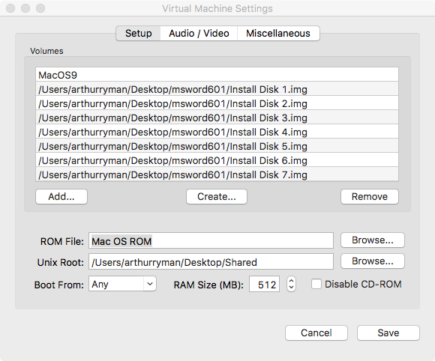

Slide 87
CarbonLib 1.6
CarbonLib is a runtime library provided by Apple
Download it from https://www.macupdate.com/app/mac/4474/apple-carbonlib

Slide 88
FileType 1.0.1
FileType is a freeware for non-commercial use application that lets you set File Info on Mac OS files
Download it from http://www.frederikseiffert.de/filetype/

